Slide 1



Weather Conditions and Climate Change with ClimateWins
Innocent Bayai
14 November 2024

Slide 2
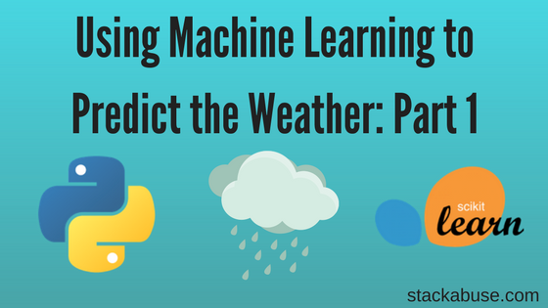
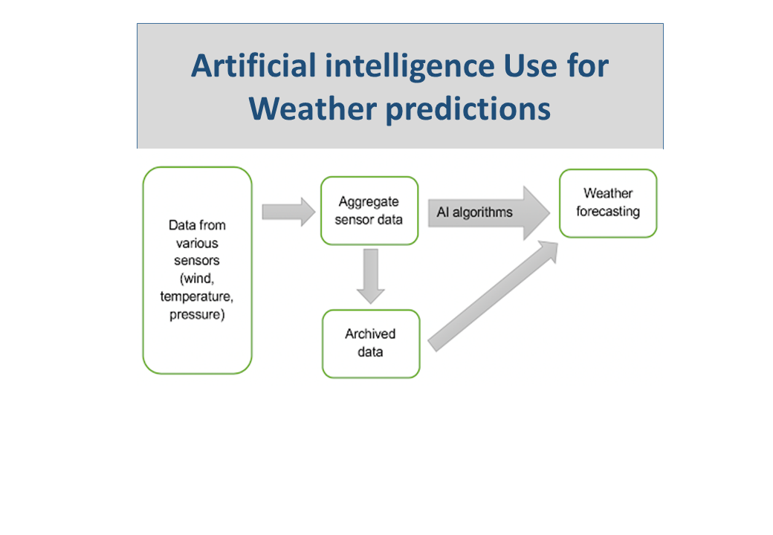
Project objective & hypotheses
ClimateWins is a European nonprofit organization interested in using machine learning to help predict the consequences of climate change around Europe and, potentially, the world.
Accordingly, ClimateWins seeks to probe the following hypotheses:
What is the best climate change prediction model?
Is it possible to estimate the maximums and minimums in temperature?
Is it possible to predict extreme weather conditions.

Slide 3


Data sources, bias, and accuracy
Daily weather data (temperature, wind speed, precipitation etc) for 18 European weather stations from 1960 to 2022 is provided.
Data sources:
The National Oceanic and Atmospheric Administration (NOAA) in the US: https://www.noaa.gov/
The Japan Meteorological Agency (JMA) in Japan: https://www.jma.go.jp/jma/indexe.html
Potential data bias and accuracy
Data is for European cities; predictions may not be applicable to other climate vulnerable places outside Europe.
Human bias in confirmation and selection – although this bias is limited through data collection by satellites.
Temperatures have been changing from the 1960s to 2022. Historical temperatures might not relate to the current paced climate change
Incorrect decisions emanating from biased/flawed models overestimate or underestimate the effects of climate change leading to inappropriate action being taken.

Slide 4
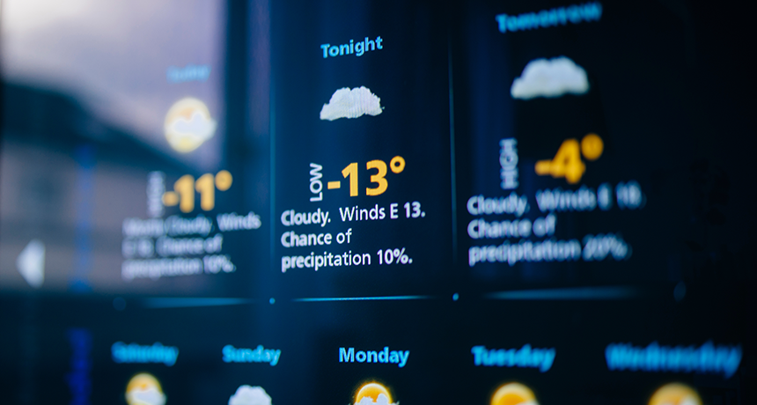
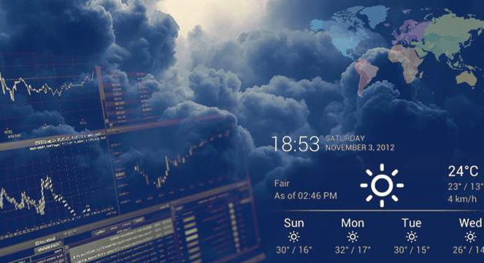
Optimization
Gradient descent optimization modeling was adopted.
Gradient descent used iterations and steps (alpha) to find the local minimum or maximum.
Optimization relied on KNN, ANN and Decision Tree methods
Confusion matrices for these methods are presented the next 3 slides.

Slide 5
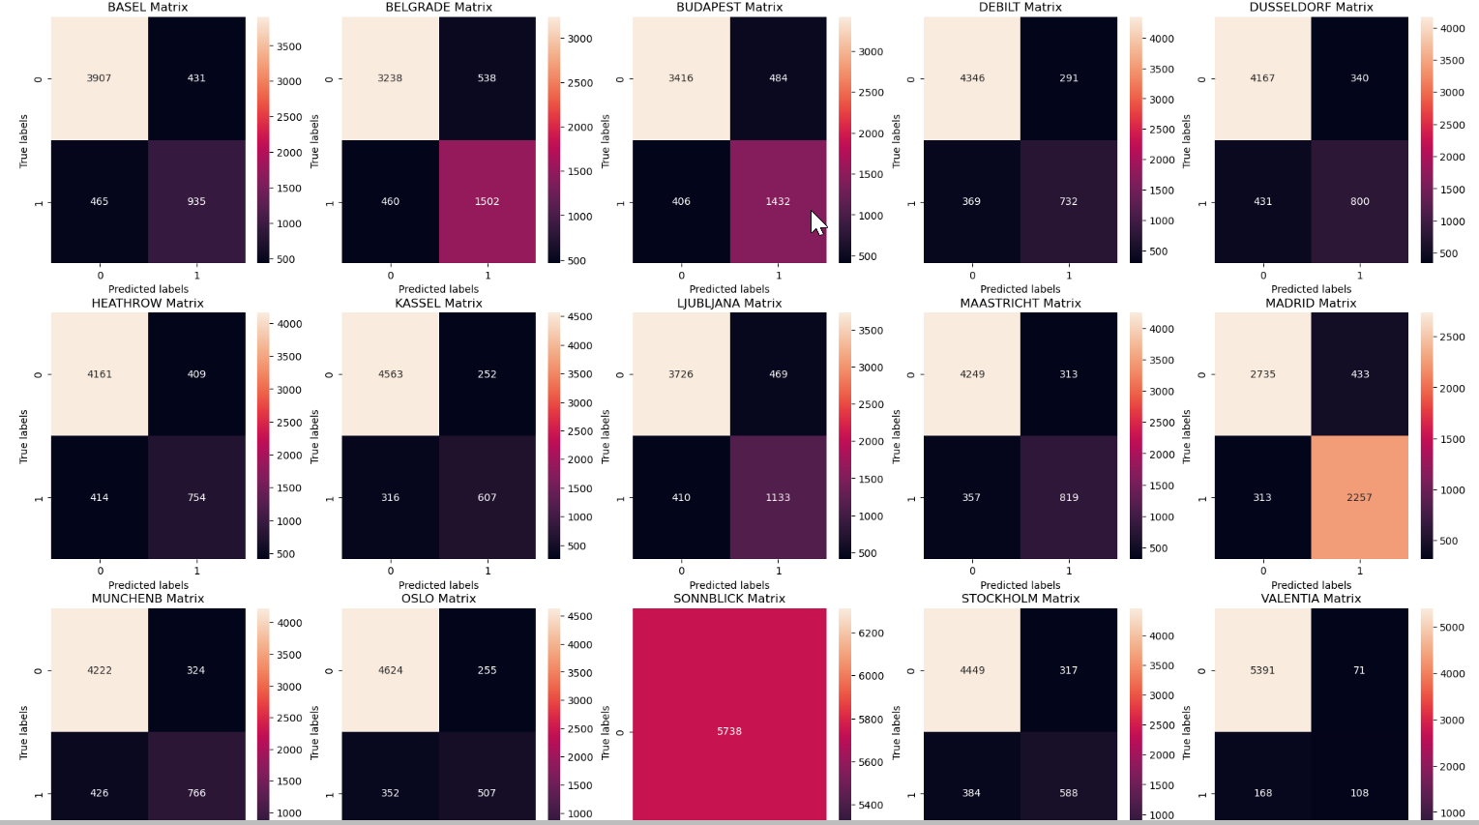
Confusion Matrix for KNN algorithm
Test set accuracy was 84%
Training set accuracy was 87%

Slide 6
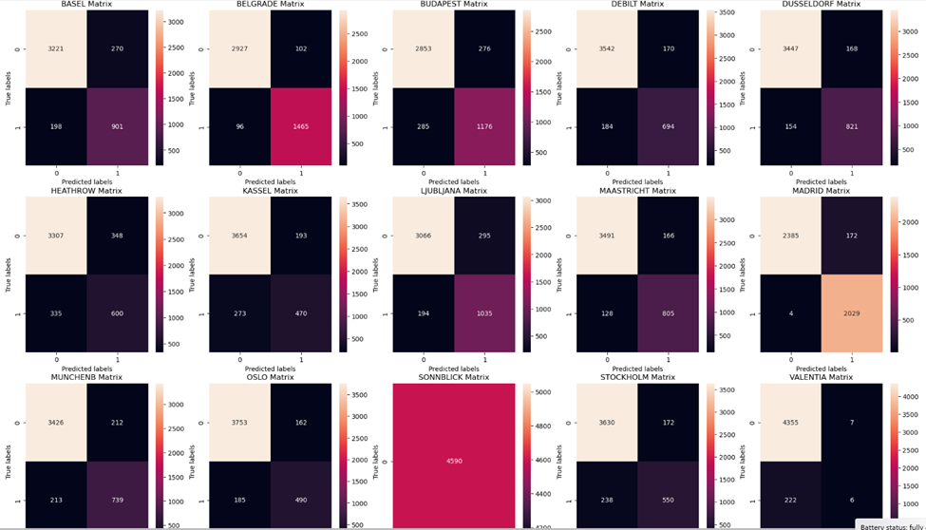
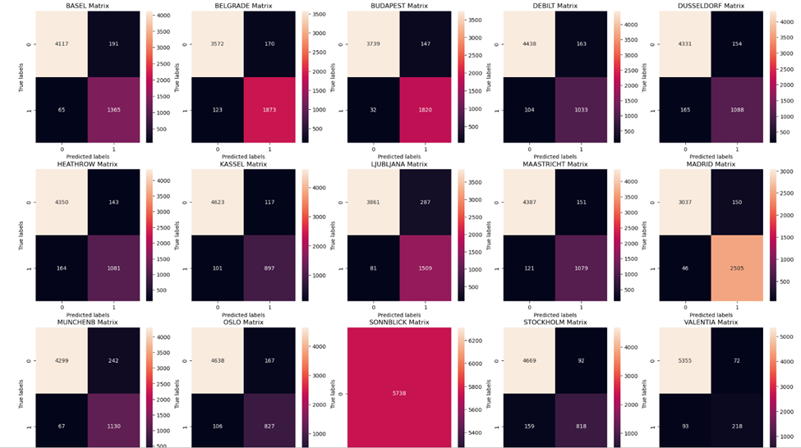
Confusion Matrices for ANN Algorithm (different scenarios)
The precision levels are 62% and 69% respectively.
This labels ANN inferior to KNN

Slide 7
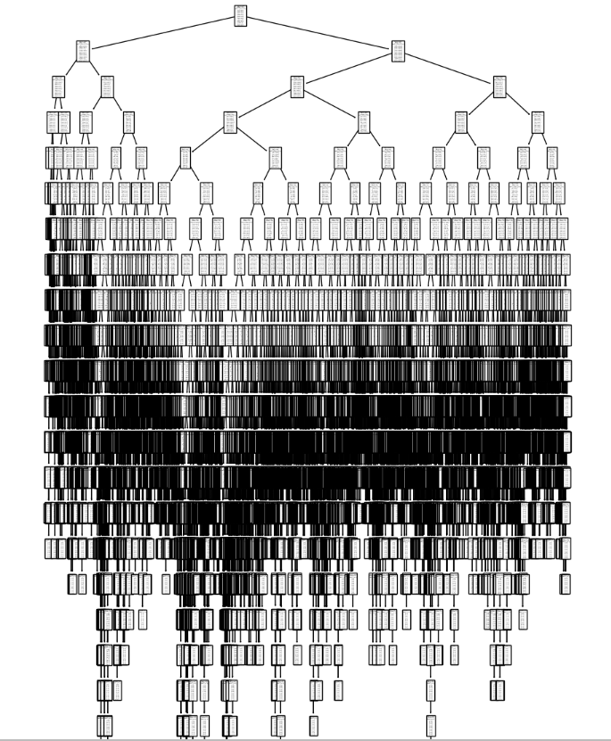
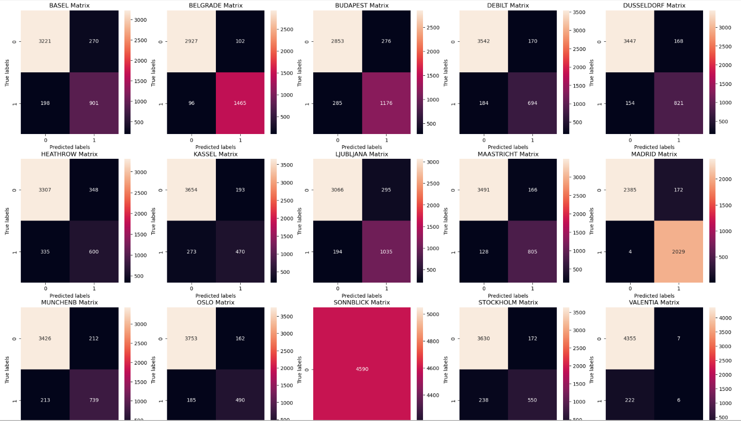
Decision Tree & ANN Confusion Matrix
The decision tree needs pruning for objective analysis

Slide 8
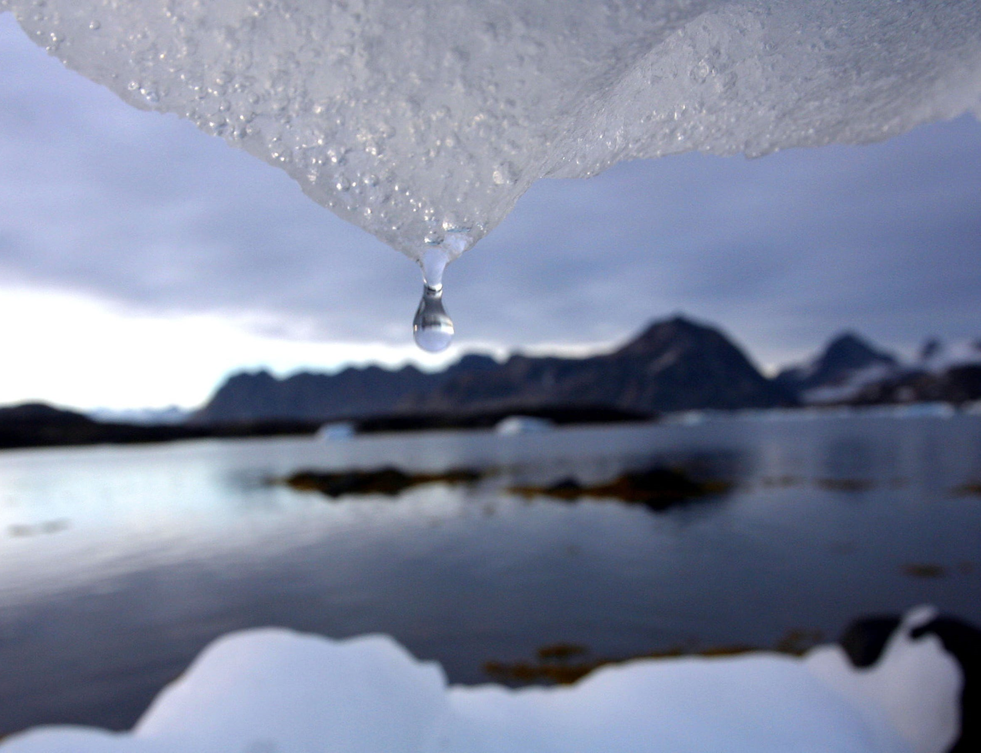
Preliminary Results & Way Forward
Machine learning can predict the max and min temperatures
Basel’s minimum temperature is -3.3, and the max is 2.08
Predictions were made for Basel, Madrid, Valentia, etc
Given the above, it is possible to predict
KNN algorithms are seemingly superior compared to ANN and Decision Tree extreme weather conditions.
Way forward
Widen data collection to incorporate global weather stations.
The KNN require further training to avoid overfitting.
Address ethical issues around climate data.
Prune decision tree.

Slide 9
Thank you

